Slide 1
TM - Human Life Transformation
Presenters :
Meghraj Kurmi
Narayan Pd. Padhya
Kashinath Parajuli
Ganesh B. Khatri

Slide 2
Problems in Society
Health Issues
Domestic Violence
Education and Unemployment

Slide 3

Health Issues
Physical health / Mental health
E.g. COVID - 19
Suicidal rate increased

Slide 4

Health
Bhutan is not a super power
Bhutan is not Developed Country either
Bhutan does not have world’s best hospital or best doctors but they have healthy and happy people
Bhutan is only country which measures Gross National Happiness of citizens

Slide 5

Health

Slide 6

Domestic Violence
Not physical violence alone
Purpose is to gain power and control over spouse, partner, girl/boyfriend, or intimate family member

Slide 7
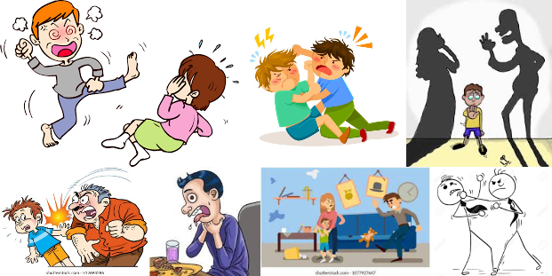
Physical Abuse

Slide 8

Emotional Abuse

Slide 9

Social Abuse

Slide 10
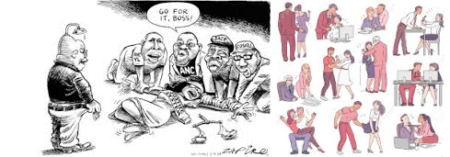
Sexual Abuse

Slide 11
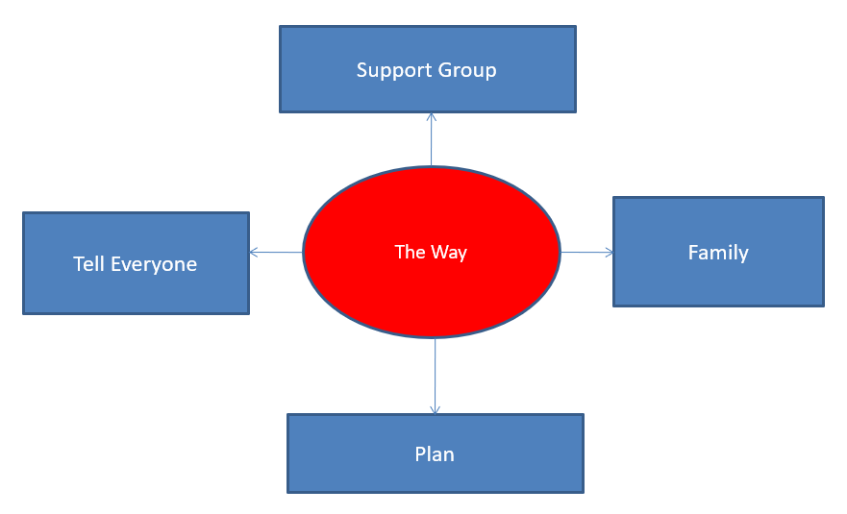
Solution ?

Slide 12
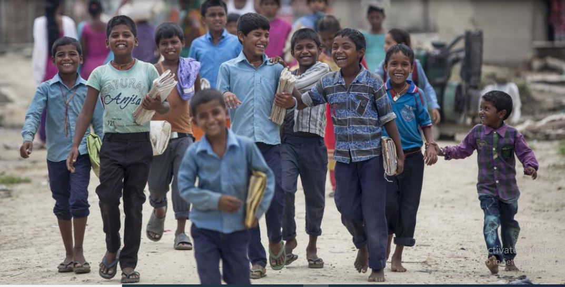
Child Education
770,000(5-12) children - out of school.
Drop rate is 4.8%
Social Exclusion
Social Norms
Gender bias
Disability Child Labor
Geographical remoteness
Lack of awareness
Poverty

Slide 13

Status of Unemployment due to Pandemic Covid-19
(80-90%) in informal sector
22.5% in business sector
40% in business sector
30.5% small and medium enterprises
Salary deduction

Slide 14

Suicide number increased during Pandemic Covid-19
5,673 suicides in 10 months
> death of people with pandemic COVID-19 up to last April.
Loss of employment
Economic problem
Social Pressure
Family burden
Mental Health
Chronic diseases

Slide 15


Solution?
Increase Literacy
Increase civilization
Increase Social awareness
Poverty alleviation
Government Stimulus package
Transcendental Consciousness
TM practice Program

Slide 16

Solution ?
All in one solution ?
Ultimate Solution ?
TM

Slide 17
Consciousness / Awareness? Mind and body are deeply connected

Slide 18

Sleep and Rest

Slide 19

Nutrition / Food

Slide 20

Exercise / Activities / Yoga Asanas

Slide 21
Transcendence
Changes perception of a person about things
Increases awareness
Positive thinking
Increases age
Time management
Healthy life

Slide 22
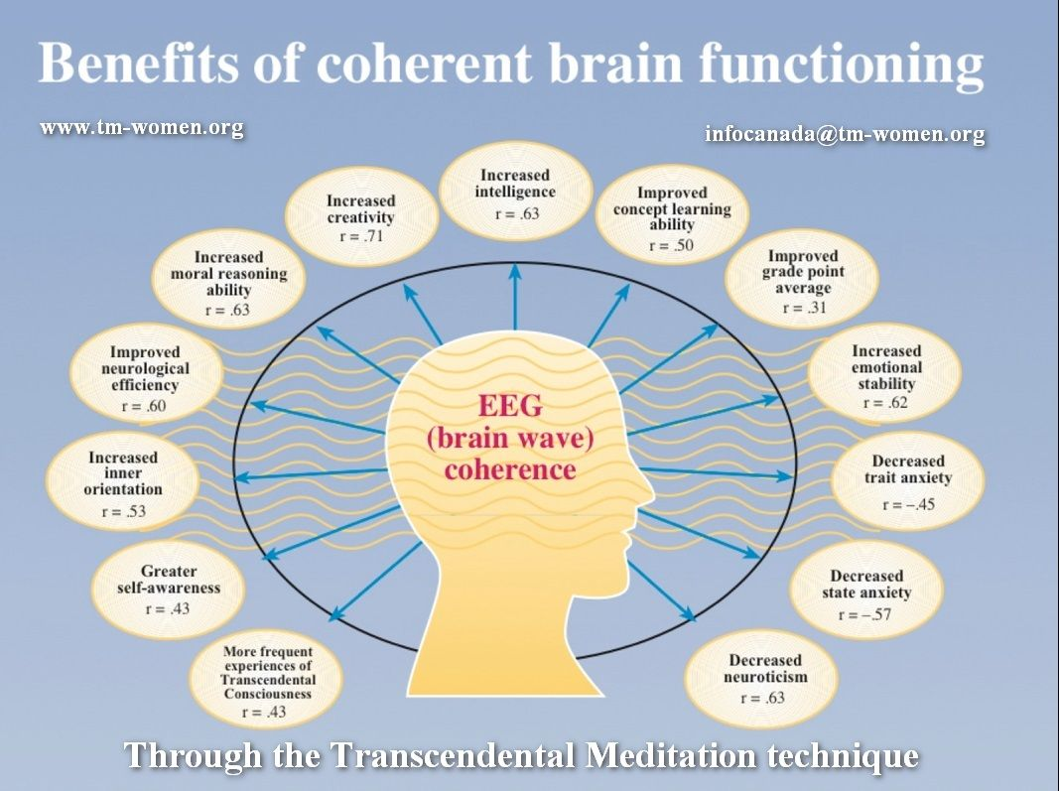

Slide 23
1960, Maharishi predicted that when even 1% of the world population learned the TM technique, whole population become peaceful.
Israel and Lebanon – reduced warfare and improved quality of life(1983) – after two months of TM by many no of meditators, war deaths dropped 76%
Reduced International Terrorism
Washington, DC – reduced violent crime, 1993 – crime rate decreased by 23.3% in two months
Ref : The Supreme Awakening, Chapter 9

Slide 24
Questions ?

